Slide 1
Recitation 2
Intermediate Macroeconomics

Slide 2
Output per person?
Define y=Y/L and k = K/L:
Determined by two factors:
Productivity
Capital per person
(Diminishing returns to capital per person)

Slide 3
Taking the Model to the Data
This is an empirical implication of the model
Using this equation to try to account for differences in output across countries is called development accounting
What data do we need check this implication?
Output, Capital, Labor
Technology

Slide 4
Taking the Model to the Data
We can measure output, capital and population (This is hard but we can try)
Harder to measure

Slide 5
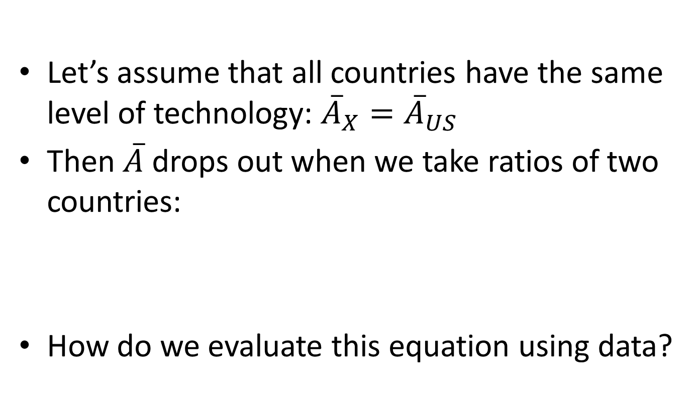

Taking the Model to the Data
Let’s assume that all countries have the same level of technology: ${\overline{A}}_{X}={\overline{A}}_{US}$
Then $\overline{A}$ drops out when we take ratios of two countries:
How do we evaluate this equation using data?
$$\frac{y_{X}^{∗}}{y_{US}^{∗}}={\left(\frac{{\overline{k}}_{X}}{{\overline{k}}_{US}}\right)}^{1/3}$$

Slide 6
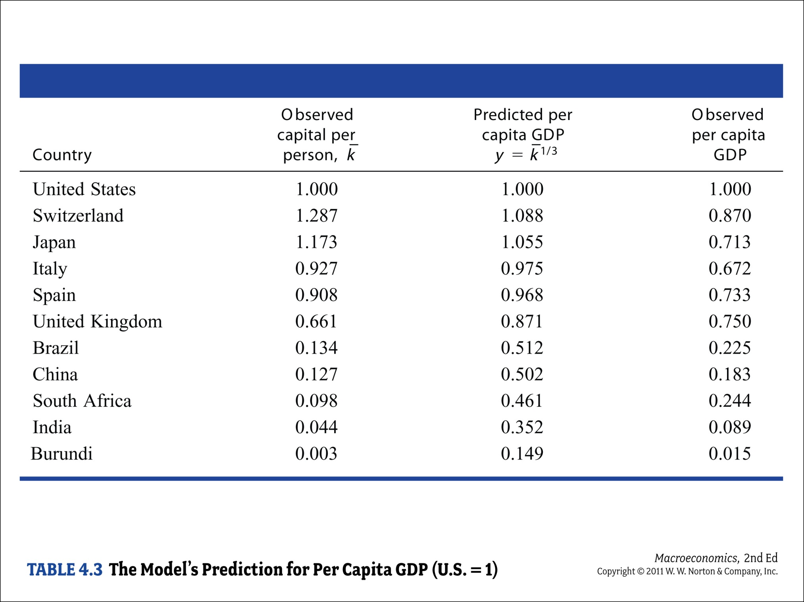

Slide 7
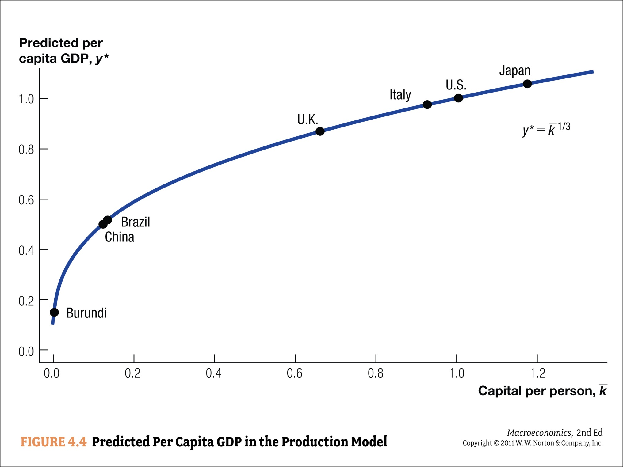

Slide 8
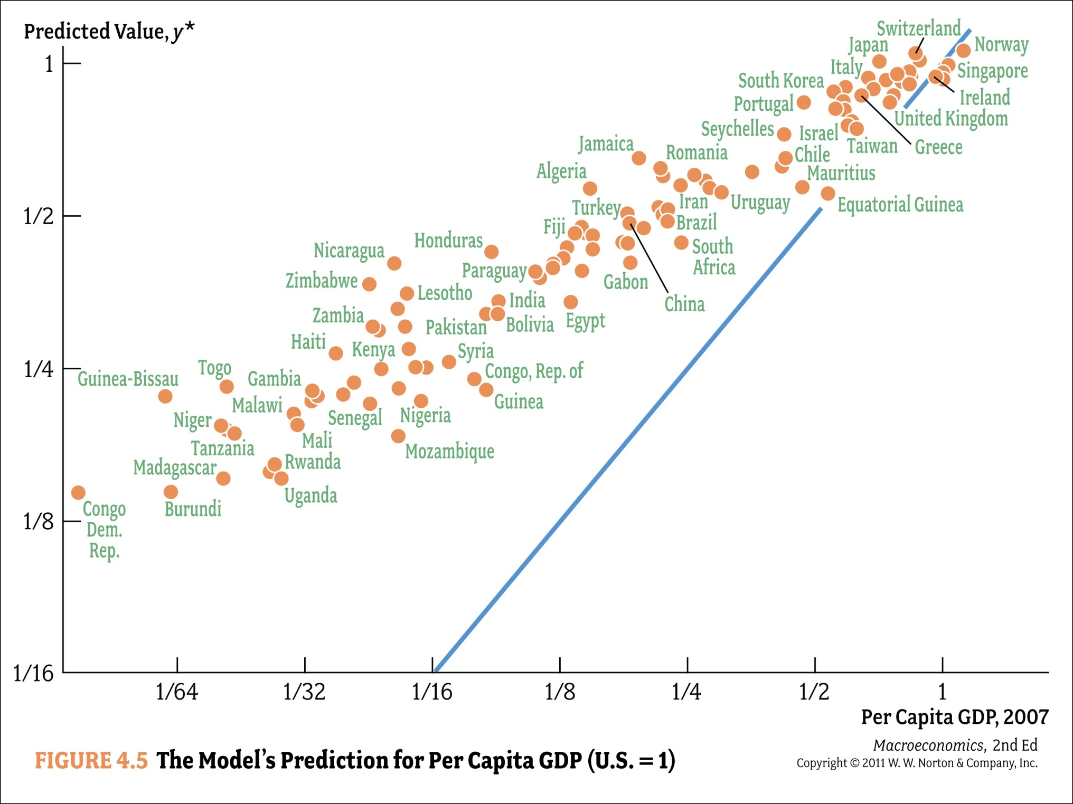

Slide 9
Taking the Model to the Data
Model fits poorly!!
It systematically overestimates output in poor countries
Poor countries produce less than their capital stocks + our model suggest should be the case
Model gets direction right:
Poorer countries have less capital per person
But it doesn’t get the magnitudes right

Slide 10
Taking the Model to the Data
What are possible reasons for model’s bad fit?
We might be mismeasuring output, capital, labor
E.g., Very hard to measure capital
Assumptions of model might be wrong (which ones?)
Functional form of production function
Is all labor the same? Skilled vs. unskilled
Maybe some critical inputs are missing (O-ring Theory)
Same level of technology in all countries

Slide 11
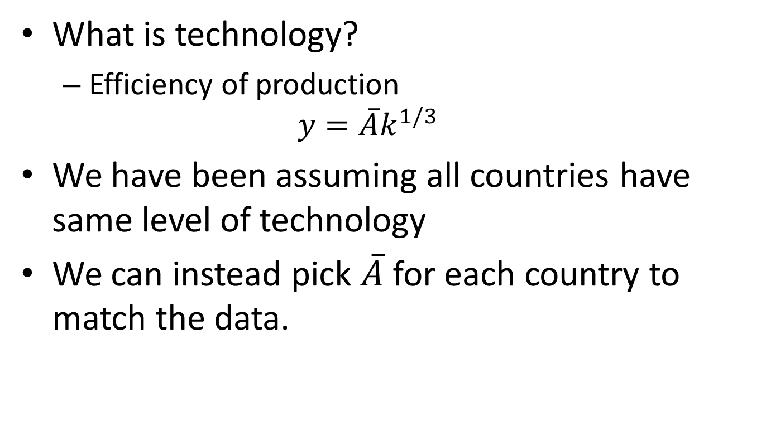
Technology
What is technology?
Efficiency of production
$$y=\overline{A}k^{1/3}$$
We have been assuming all countries have same level of technology
We can instead pick $\overline{A}$ for each country to match the data.

Slide 12
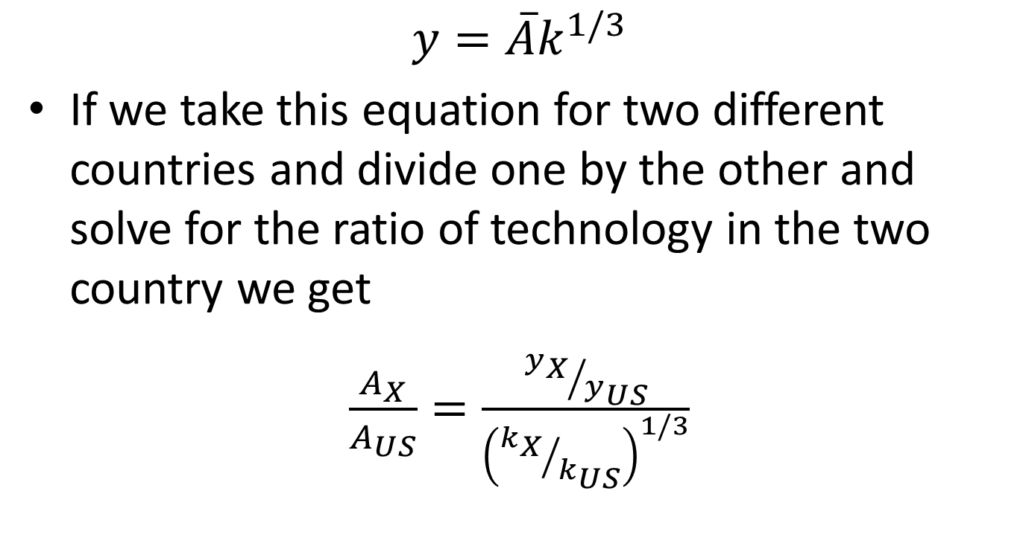
How “Efficient” Are Different Countries?
$$y=\overline{A}k^{1/3}$$
If we take this equation for two different countries and divide one by the other and solve for the ratio of technology in the two country we get
$\frac{A_{X}}{A_{US}}=\frac{{y_{X}}/{y_{US}}}{{\left({k_{X}}/{k_{US}}\right)}^{1/3}}$

Slide 13
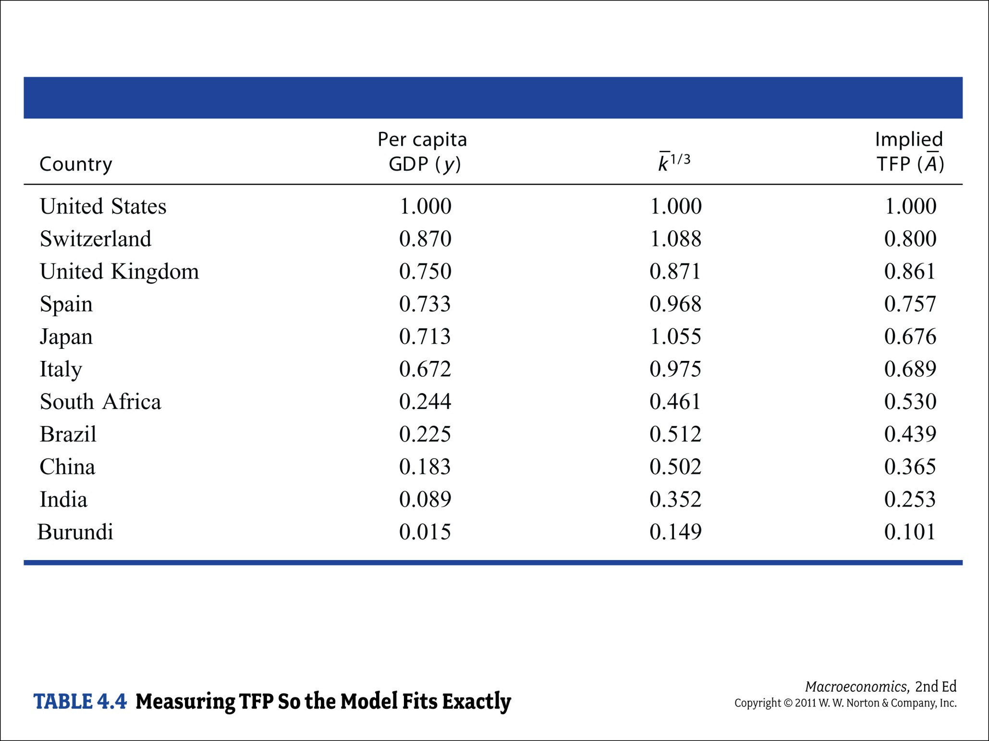

Slide 14
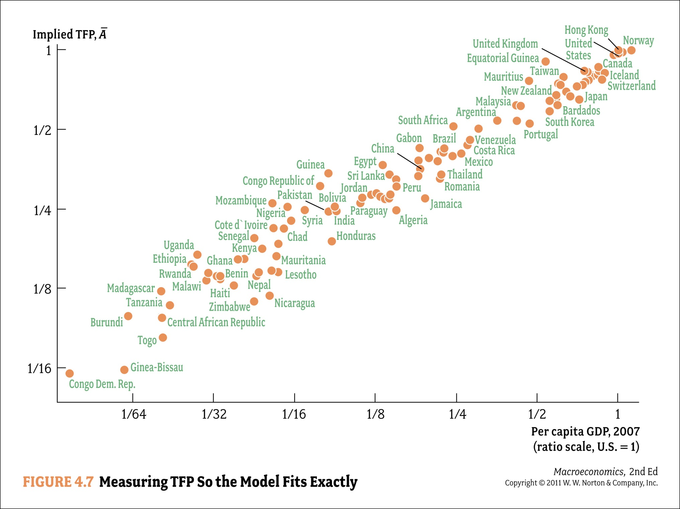

Slide 15
Taking Model to the Data
Does this mean we have explained differences in output per person?
No!!!
We didn’t have independent data on TFP
Differences in capital could explain a (small) fraction of differences in output per capita
Part we assign to TFP is
“a measure of our ignorance”
TFP difference: factor of 10
Need to explain TFP differences

Slide 16
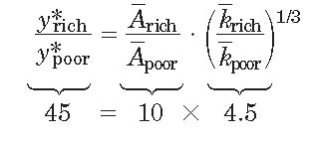
How Much Have We Explained?
Five richest and five poorest in 2000:
Crucial question:
Why does TFP (the measure of our ignorance) differ so much across countries?

Slide 17
Taking Model to the Data II (Lucas)
(Optional)
Firm optimization implies:
or
and also
a little bit of algebra yields
If technology is the same across countries:

Slide 18
Return on Capital in Developing World
(Optional)
Consider the case of India:
Output per worker was about 15 times lower in India than in U.S. in 1990
Returns to capital should be 15²=225 times higher
What should this imply?
Capital should flow from rich countries to poor countries!!!!

Slide 19
Capital Flows
(Optional)
In 1990:
Richest 20% of countries received 88% of private capital inflows
Poorest 20% of countries received 1% of private capital inflows
Lucas (1990): Why doesn’t capital flow from rich to poor countries?
Perhaps technology is not the same

Slide 20
Understanding TFP Differences
Human Capital
Technology
Institutions
Misallocations

Slide 21
Review of Calculus of Variations
Refer to Lecture Slides

